Slide 1
NXT WAVE
our courses
Boost your career

Slide 2
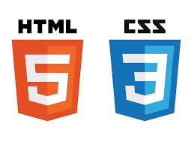
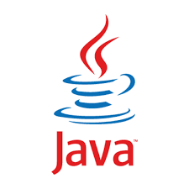


What we have learned Technologies

Slide 3
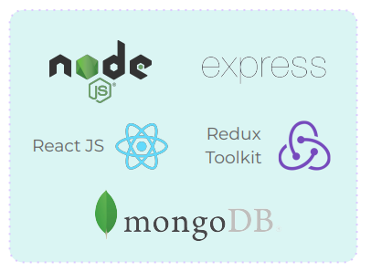
What will you learn Technologies (~50 Sessions)

Slide 4

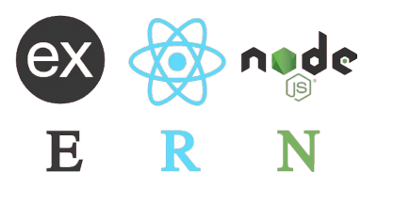
Introduction MERN Stack
MERN stands for MongoDB, Express JS, React JS and Node JS

Slide 5
Introduction MERN Stack
MERN Stack is a JavaScript Stack that is used for easier & faster deployment of full stack web applications

Slide 6


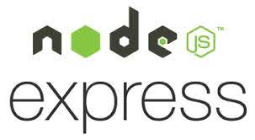
MERN Stack
Application Flow
Client-side/Frontend
Client-side/Frontend
Client-side/Frontend

Slide 7
Why MERN Stack?
MERN Stack
Most Companies choose the MERN stack for development
● Great community
● Full Stack
● Fast learning curve
● Open Source

Slide 8
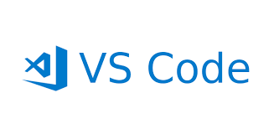
IDE
VS Code
VS Code is one of the most popular IDE used by majority of Software Developers In the Stack Overflow Developers Survey 2021, VS Code Ranked 1 among all the IDEs
Source: stackoverflow.com

Slide 9
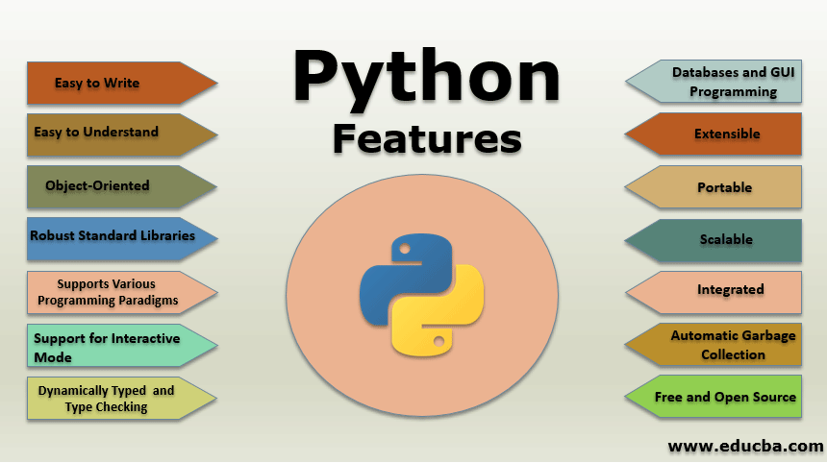

Slide 10
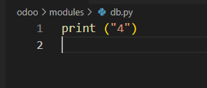

Approaching Problems
Question - 1
Write a program to print the greatest among the two numbers
INPUT
OUT PUT

Slide 11
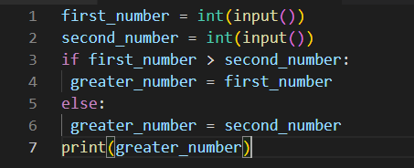
Question - 1
Code

Slide 12
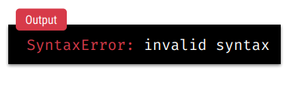
Code
Possible Mistakes

